Slide 1

Pareto NBD Model July 2015

Slide 2


Background and Approach:
Used for Customer life time value (LTV) prediction by providing the best informed guess about a particular customer’s future purchasing
Many approaches use a two step scheme for this estimation:
Forecast the future number of Transactions of each individual
Then, estimate the individual average profit per transaction
Computation of the probability that a particular customer is still “active”, given information about his past behavior and the parameter estimates

Slide 3
Underlying Assumptions of the Model:
The Pareto/NBD model is based on five assumptions:
While active, the number of transactions made by a customer in a time period of length t is distributed Poisson with mean λt
Heterogeneity in the transaction rate λ across customers follows a gamma distribution with shape parameter r and scale parameter α
Each customer has an unobserved “lifetime” of length τ . This point at which the customer becomes inactive is distributed exponential with dropout rate μ.
Heterogeneity in dropout rates across customers follows a gamma distribution with shape parameter s and scale parameter β.
The transaction rate λ and the dropout rate μ vary independently across customers

Slide 4
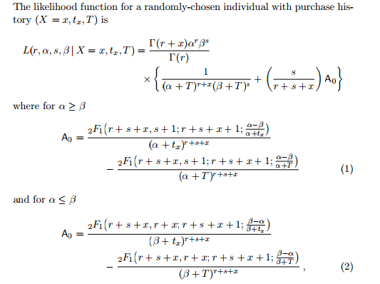
Mathematical formulation of the Model:
For Detailed literature review please go through the following link:
http://brucehardie.com/notes/009/pareto_nbd_derivations_2005-11-05.pdf
https://www.google.com.ar/url?sa=t&rct=j&q=&esrc=s&source=web&cd=1&cad=rja&uact=8&ved=0CCEQFjAA&url=https%3A%2F%2Flirias.kuleuven.be%2Fbitstream%2F123456789%2F175502%2F1%2FKBI_0726.pdf&ei=yW2-VKW8HYH5mAXOxoHwDQ&usg=AFQjCNF9IKbZnY6yjMcx4SEzTuZDl37pMQ&bvm=bv.83829542,d.dGY
http://www.brucehardie.com/notes/008/pareto_nbd_MATLAB.pdf

Slide 5
Thank You

